Slide 1
Travel Planner - AI agent
IBM AICTE PROJECT
Presented By:
Student name : Kumari Anshika
College Name & Department : Shri Ramswaroop Memorial University, CS Department

Slide 2
OUTLINE
Problem Statement
Technology used
Wow factor
End users
Result
Conclusion
Git-hub Link
Future scope
IBM Certifications

Slide 3
Problem Statement
Travel planning is often time-consuming and fragmented, involving multiple platforms for bookings, research, and scheduling. Users struggle to align preferences, budgets, and real-time changes. An AI-powered Travel Planner Agent addresses this by offering personalized, data-driven trip planning—integrating transport, accommodation, maps, weather, and updates into a seamless, intelligent experience.
Proposed Solution: Imagine having a smart travel buddy that does all the heavy lifting for you. This AI-powered assistant learns what you like, finds the best places to go, plans your schedule, and even handles your bookings. It keeps you updated with real-time info like weather and delays—making travel simple, stress-free, and tailored just for you.

Slide 4
Technology used
IBM cloud lite services
Natural Language Processing (NLP)
Retrieval Augmented Generation (RAG)
IBM Granite model

Slide 5
IBM cloud services used
IBM Cloud Watsonx AI Studio
IBM Cloud Watsonx AI runtime
IBM Cloud Agent Lab
IBM Granite foundation model

Slide 6
Wow factors
This AI Travel Planner Agent — your smart, always-on travel companion. It transforms complex trip planning into a smooth, enjoyable experience by tailoring journeys to your preferences, budget, and real-time conditions. From suggesting destinations to handling last-minute changes, it ensures every trip is optimized, stress-free, and unforgettable.
Unique features:
Learns your travel style for hyper-personalized plans
Uses real-time data for weather, transport & local events
Auto-generates smart, efficient itineraries
Manages bookings and alerts you to changes
Integrated with maps, guides, and booking platforms
Conversational, responsive, and always ready to assist

Slide 7
End users
Travel Agencies & Agents
Individual Travelers (Solo Travelers & Families)
Businesses & Professionals Travelers
Hospitality & Tourism Boards
Tour Operators & Local Guides

Slide 8
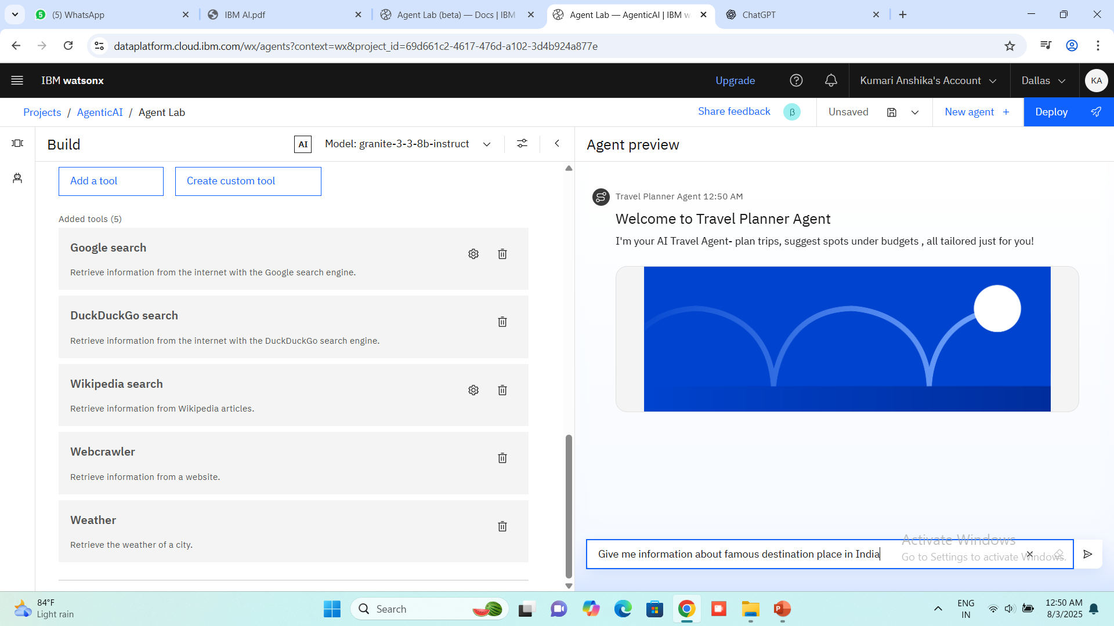
Results

Slide 9
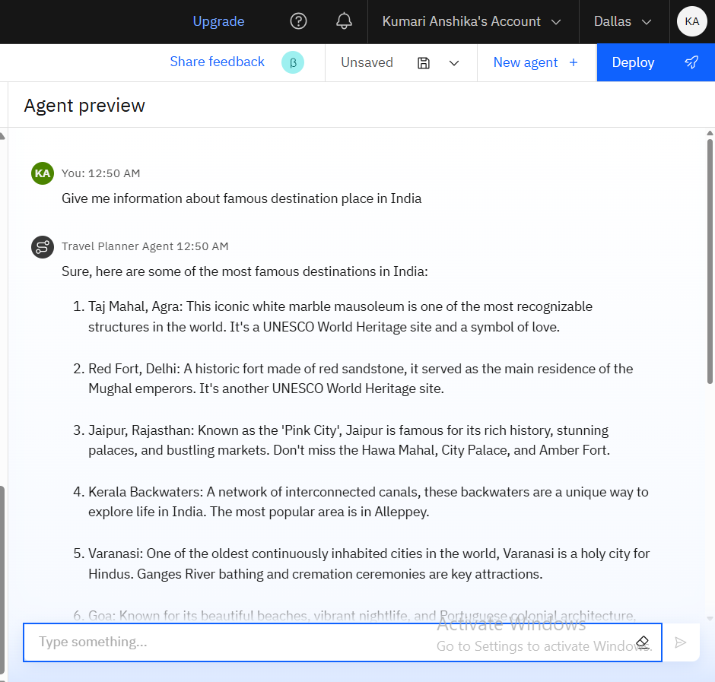
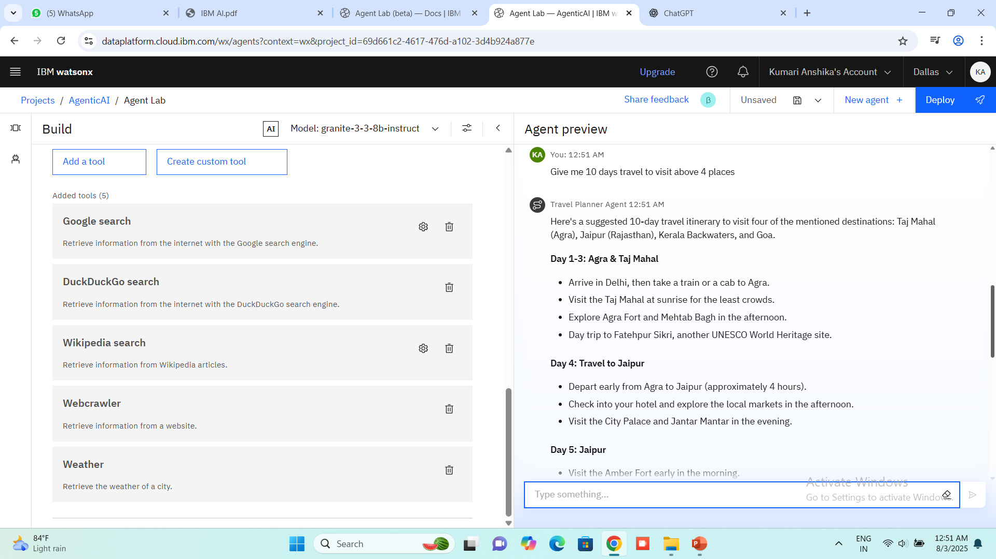
Results

Slide 10
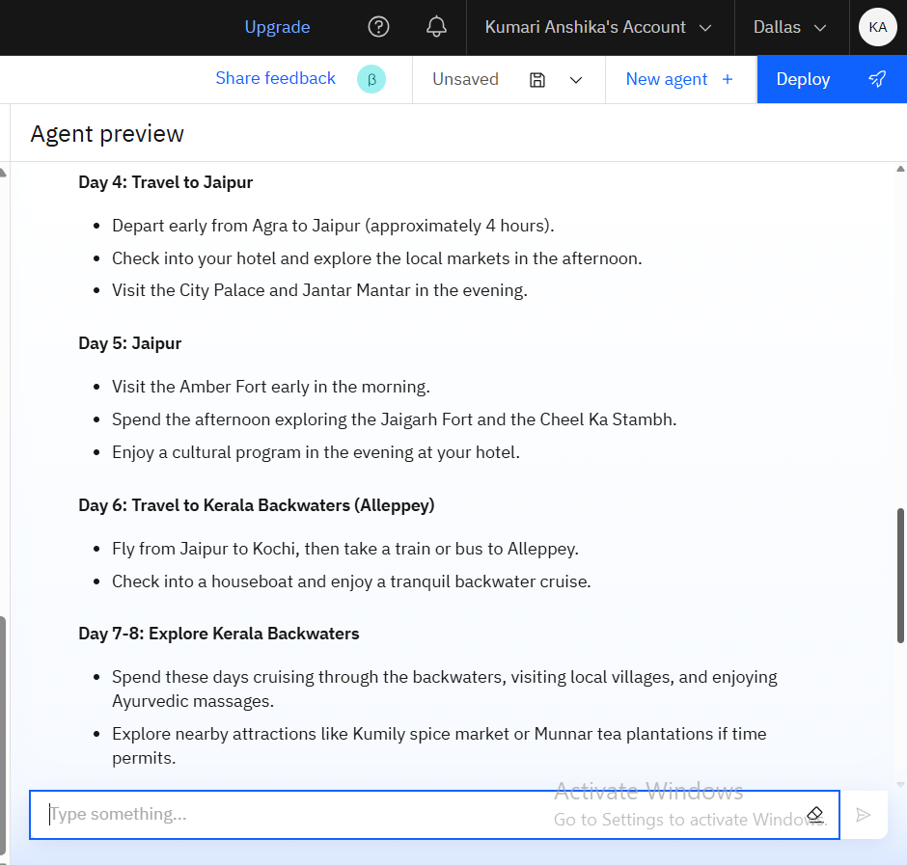
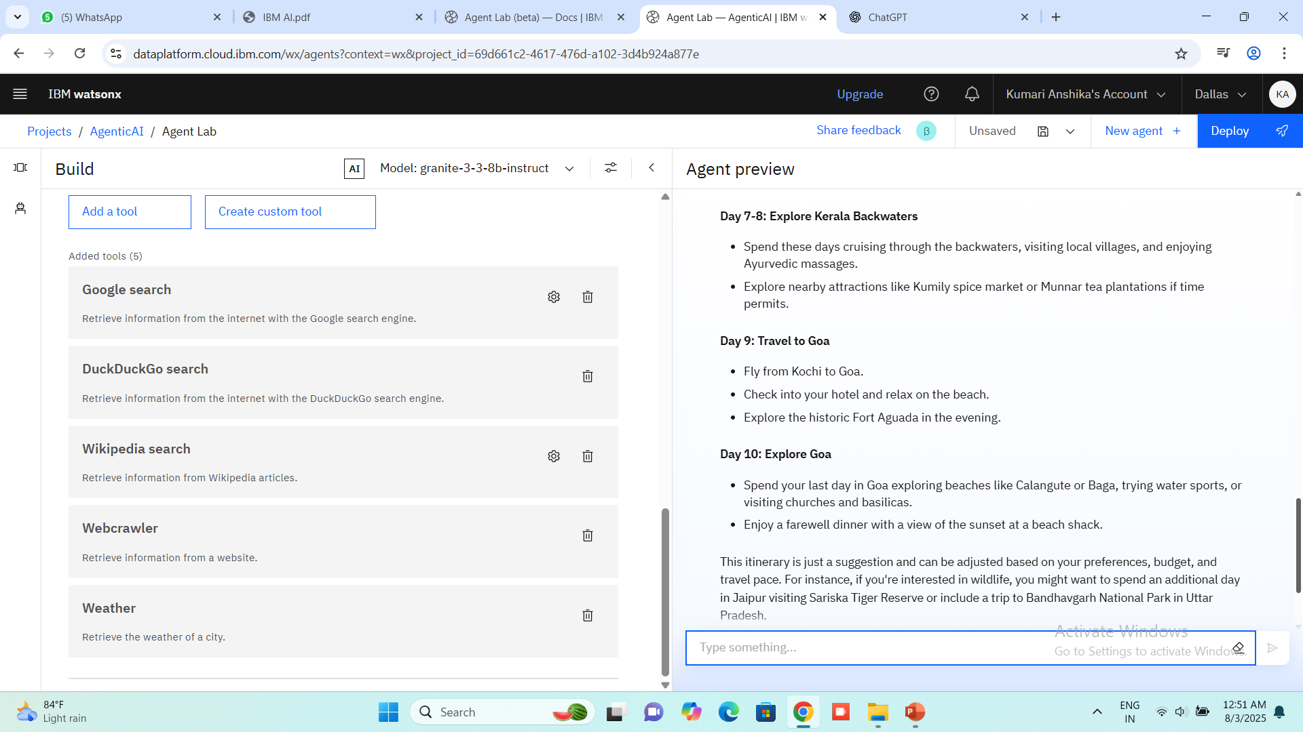
Results

Slide 11
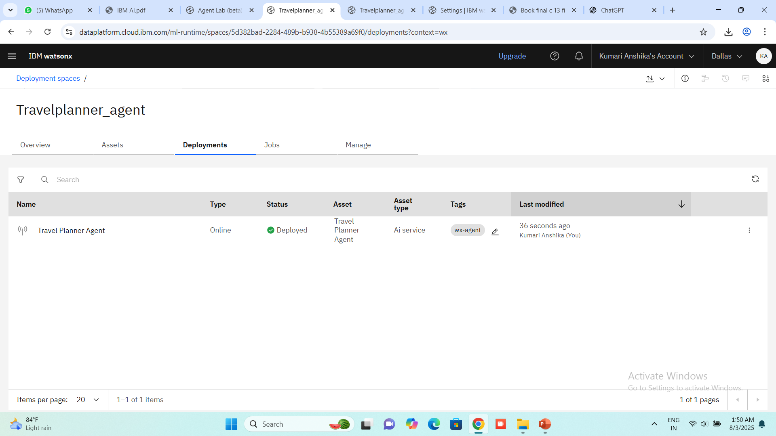
Results
Deployed AI Agent

Slide 12
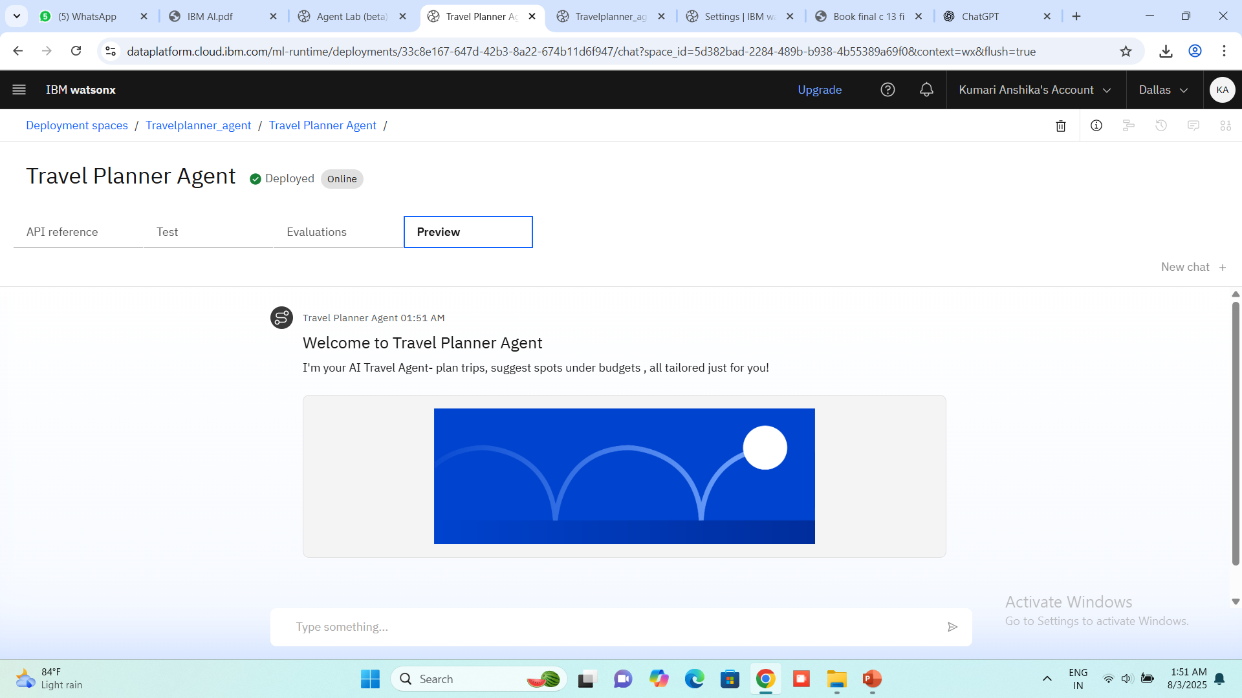
Results
Deployed AI Agent

Slide 13
Conclusion
This AI Agent can:
Transforms travel planning into a smart, seamless, and personalized experience
Saves time and effort by automating research, itinerary building, and bookings
Adapts to user preferences, budgets, and changing travel conditions in real time
Optimizes the entire journey from destination discovery to on-the-go adjustments
Enhances convenience with AI-driven suggestions, alerts, and 24/7 assistance
Ideal for individuals and businesses, making travel stress-free, efficient, and enjoyable

Slide 14
Future scope
Integration with IoT devices for real-time, smart travel support
Advanced multilingual and culturally adaptive recommendations
Predictive travel planning based on trends and user behavior
Seamless business travel tools with calendar and expense sync
Voice- and gesture-based interaction for hands-free usability
Eco-friendly travel suggestions with carbon footprint tracking

Slide 15
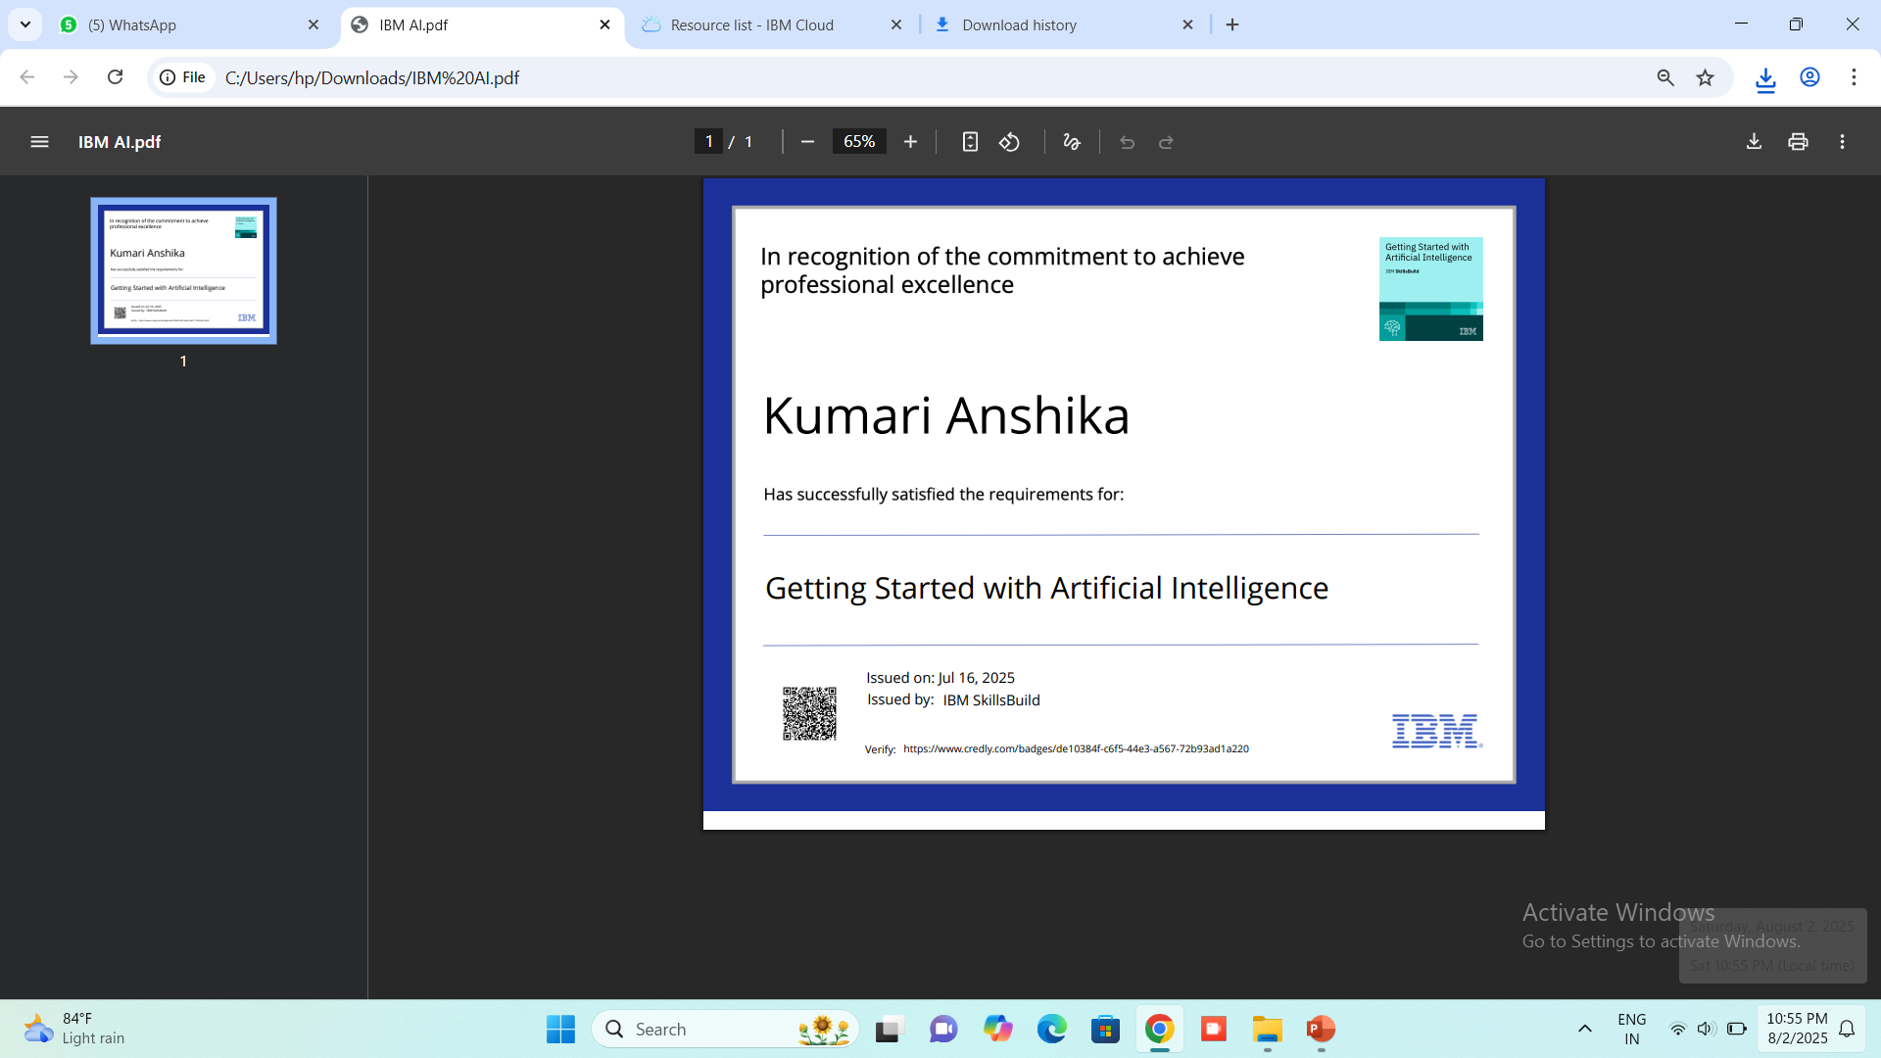
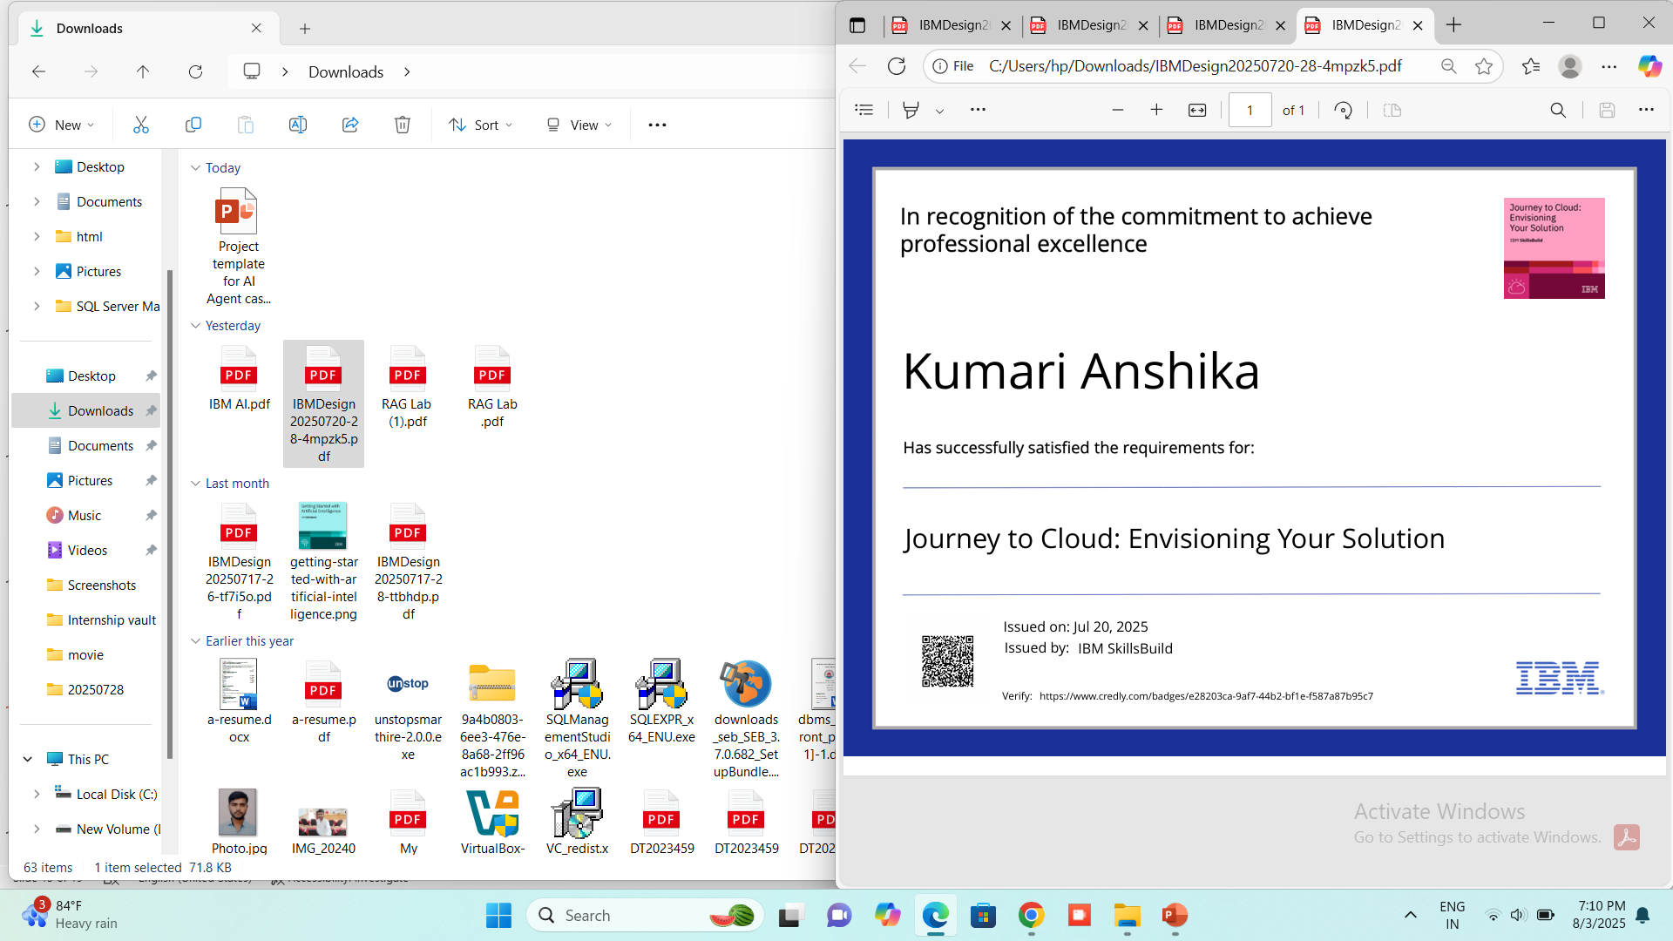
IBM Certifications

Slide 16
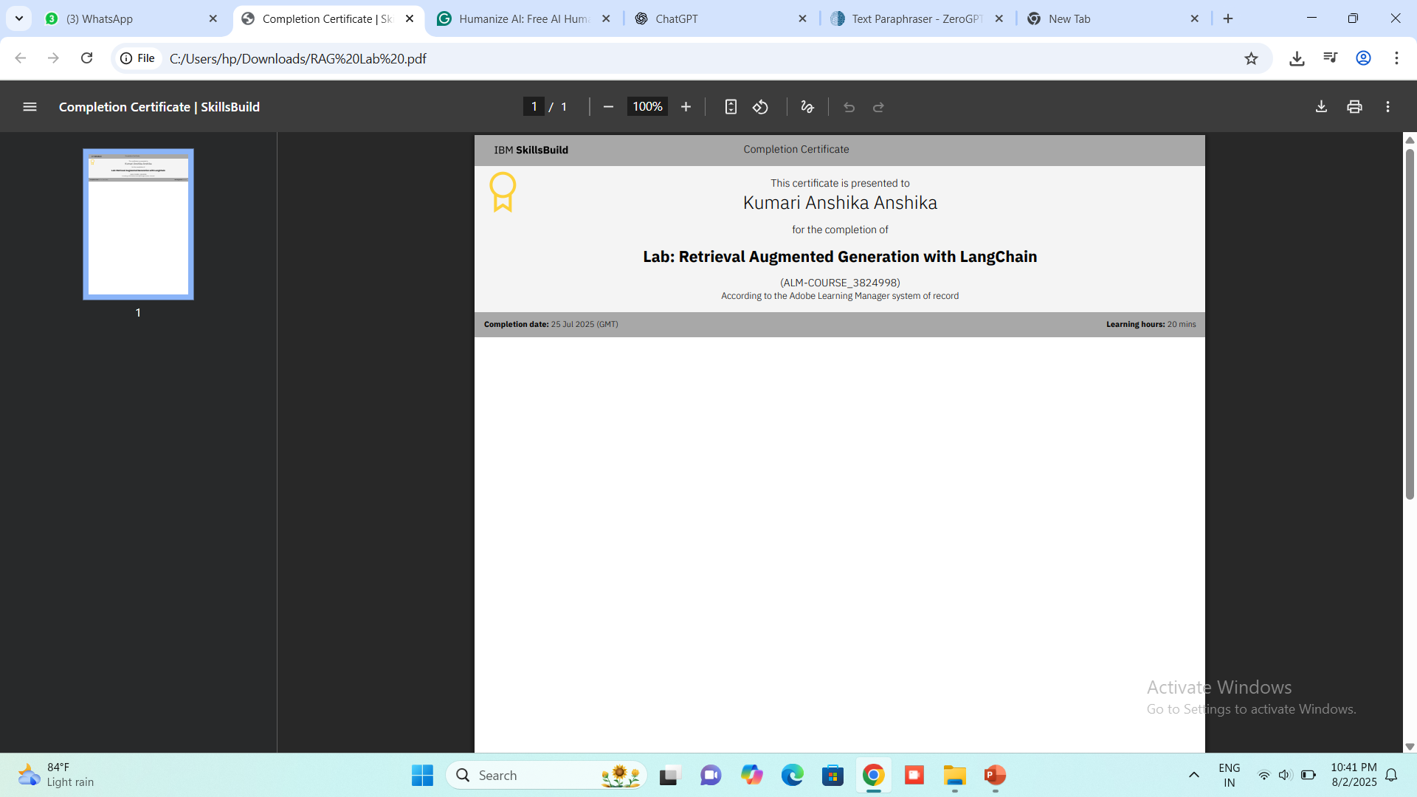

Slide 17
GitHub Link
https://github.com/kumari-Anshika/IBM-Cloud-Travel_planner_AIagent

Slide 18
THANK YOU

